Slide 1
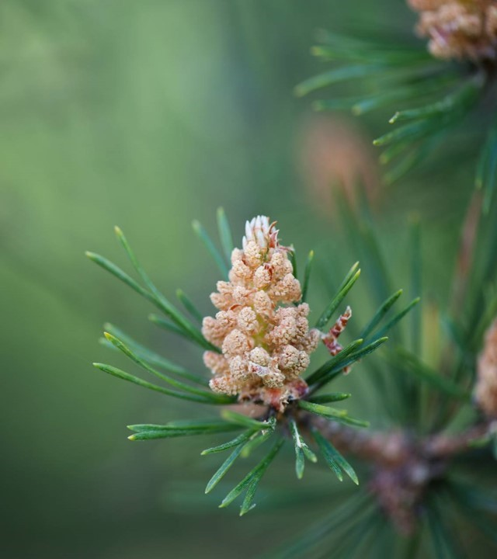
Moffat Bay Lodge
Jaci Brown Austin Moore
Jon Green

Slide 2
About us
Project Requirements:
Presentation with slides for each of the following, at minimum:
Introduction of Team
Sample Prototypes
ERD
Description of at least five (5) tests created, and results of those tests
Lessons Learned as a team.
Screen Capture of live site, depicting the functionality of the following:

Slide 3
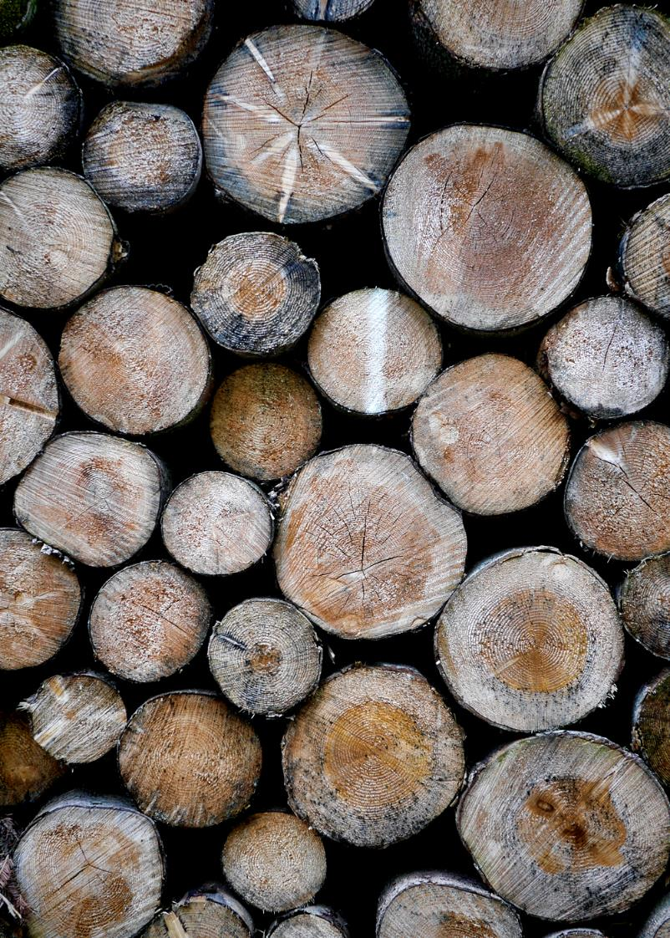
Team overview

Slide 4
Rough prototypes

Slide 5
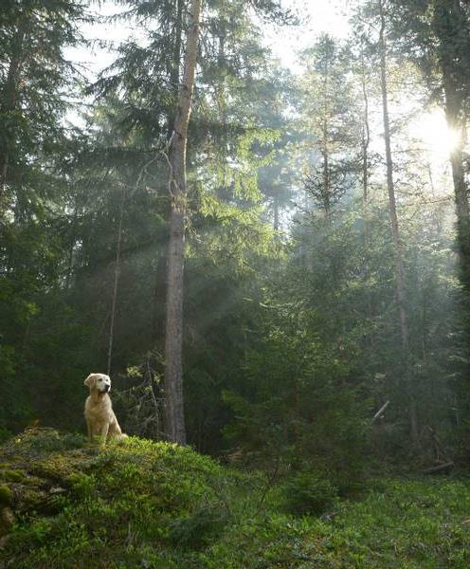
Prototypes in action
More current images of protype meeting real life

Slide 6
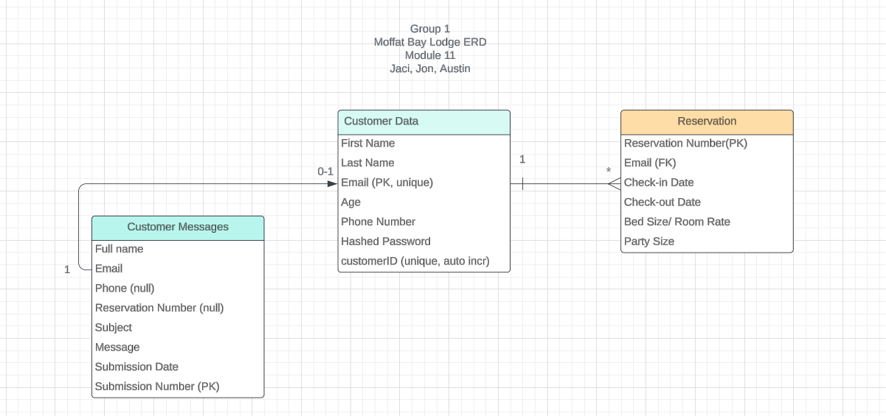
ERD AND TESTING

Slide 7
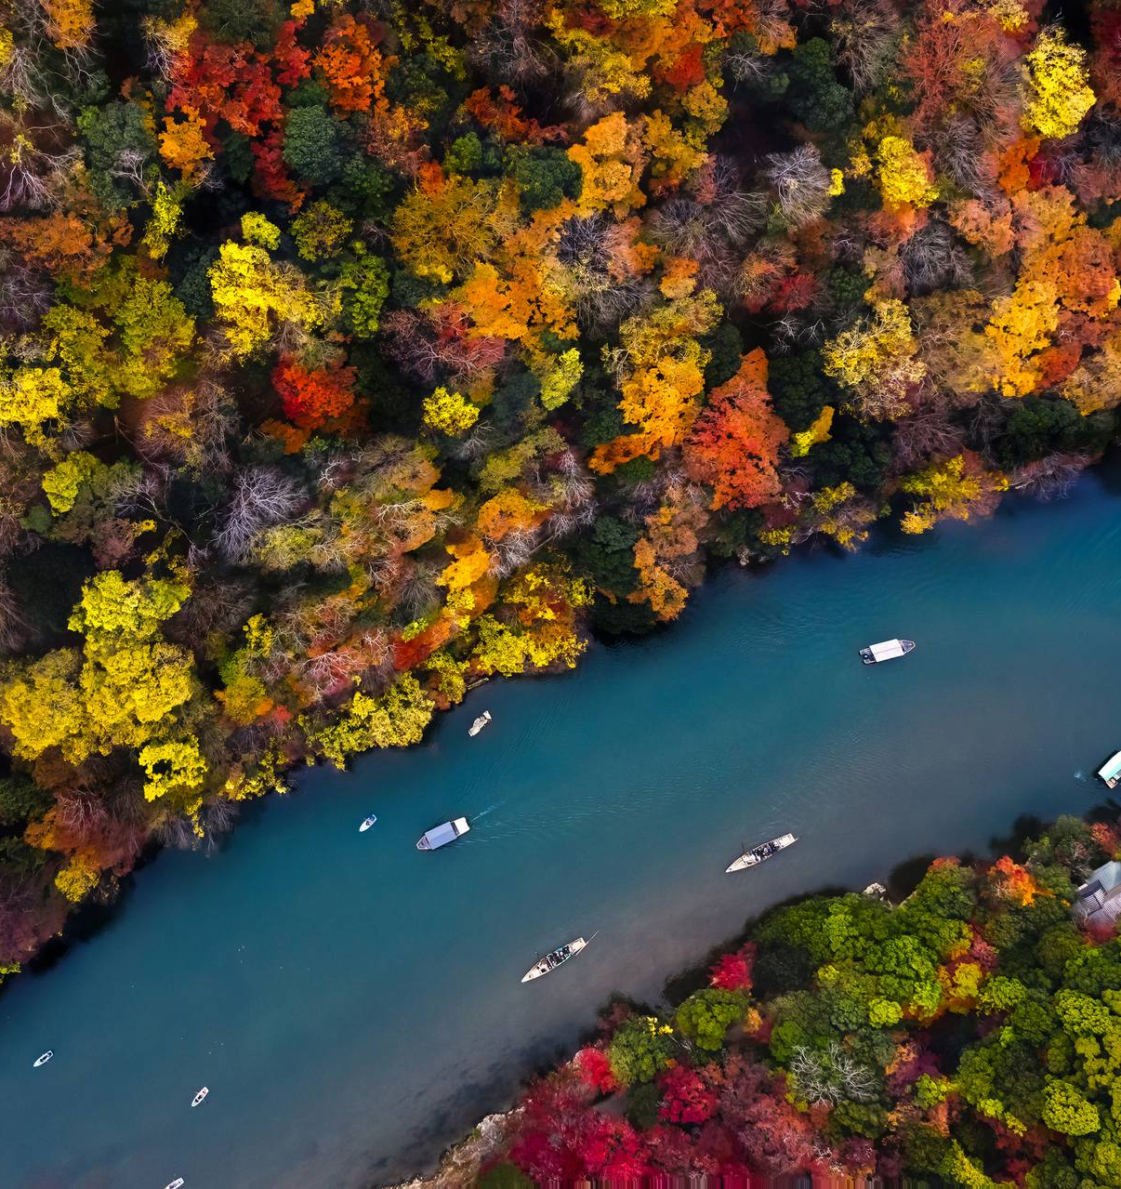
More testing
Highlight feedback/errors
“links to attractions”

Slide 8
Probably more testing
Add images and one – two sentences explaining test thought and outcome
Add pics of success and failure if possible

Slide 9
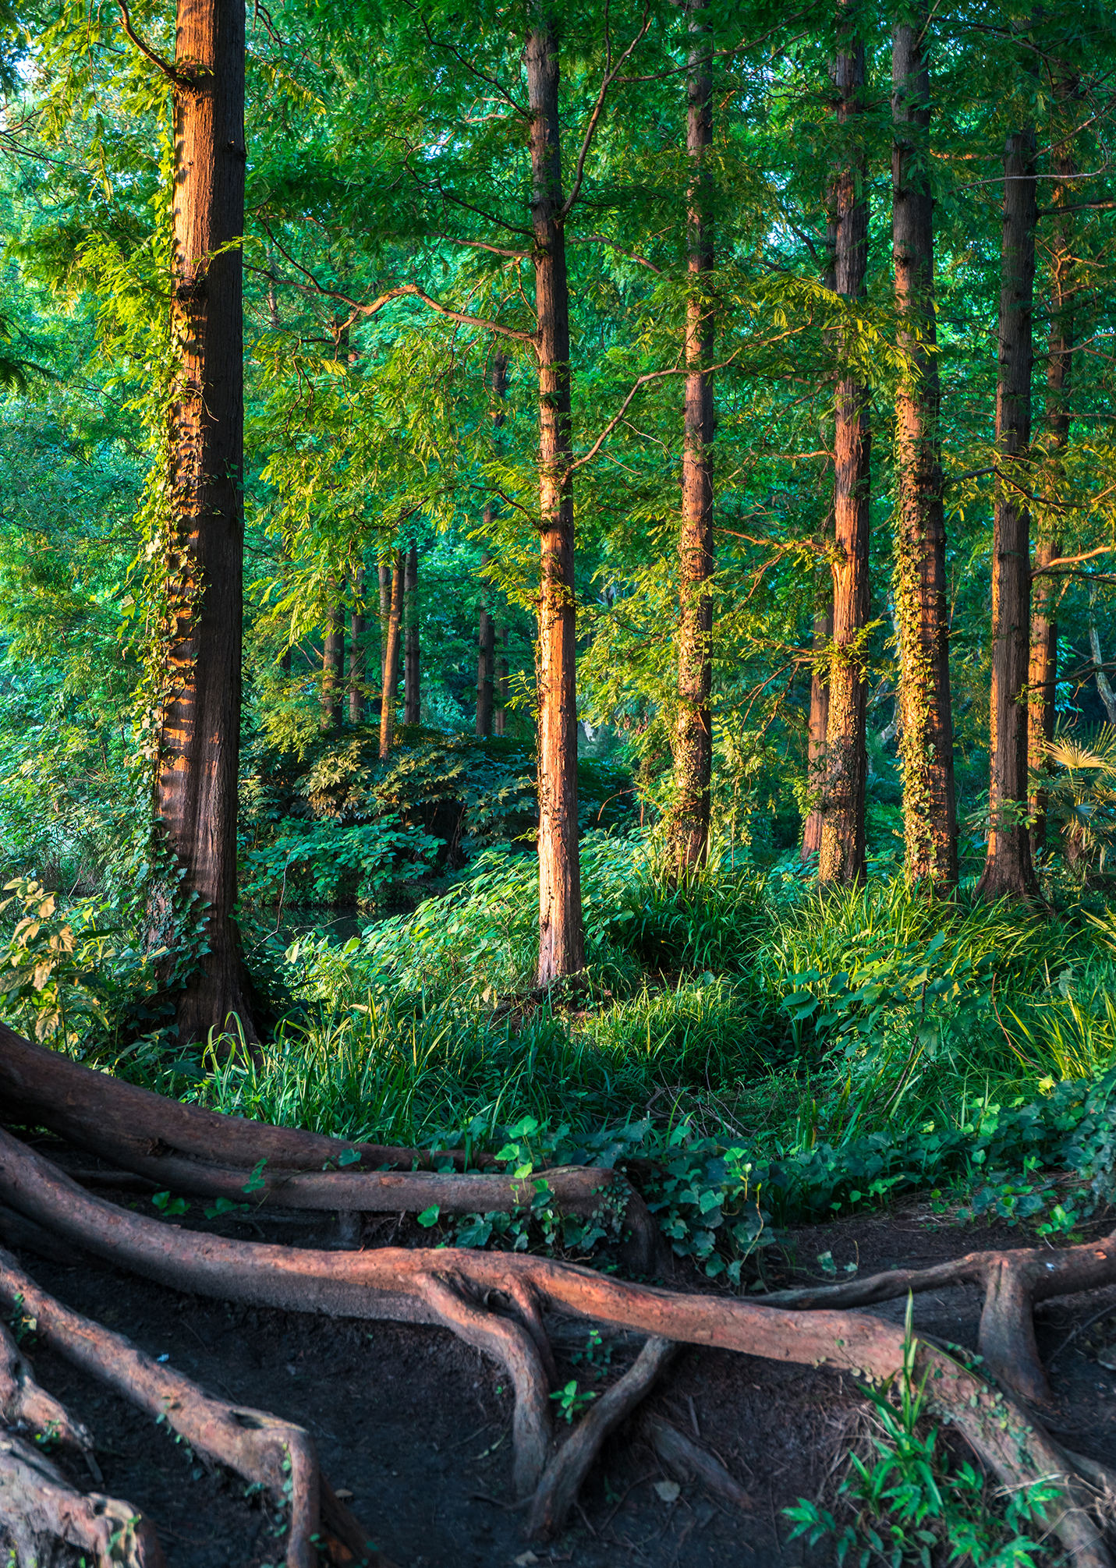
Screen captures of site

Slide 10
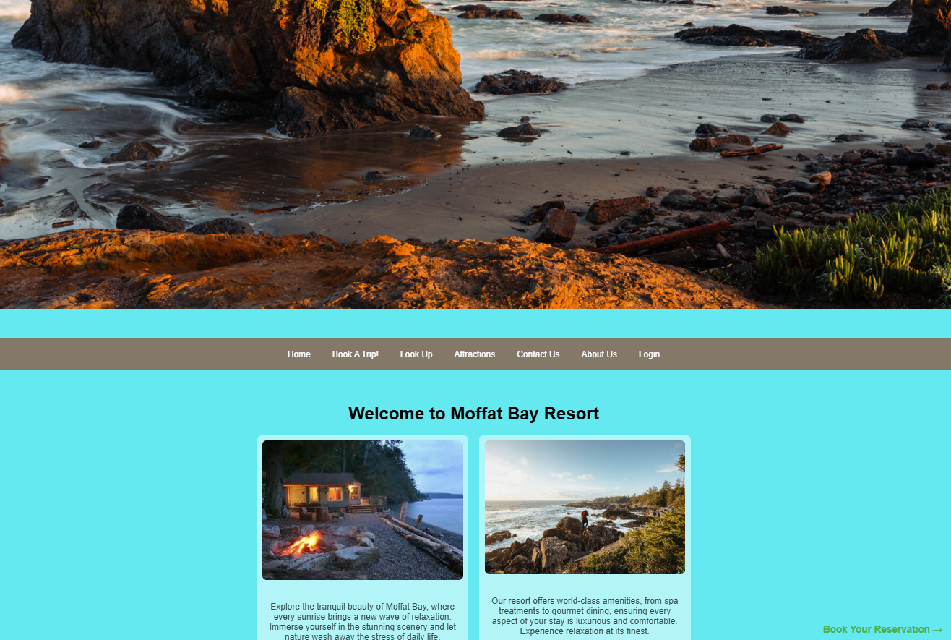
Landing page
Main picture is to capture the customers attention, showcasing amazing views by the resort. Home page has header bar along with other pictures and details of the resort overall.

Slide 11
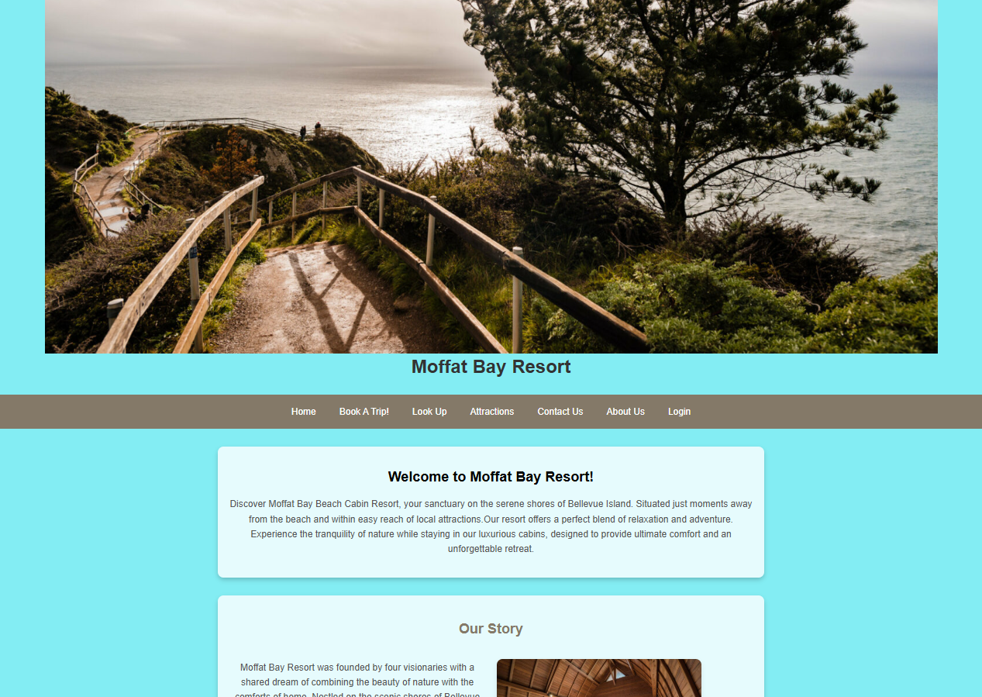
About us page
Different view of the resort at the top of the page. About Us gives more of a story and what you can experience while here along with a booking button at the bottom of the page after reading through an immersive experience.

Slide 12
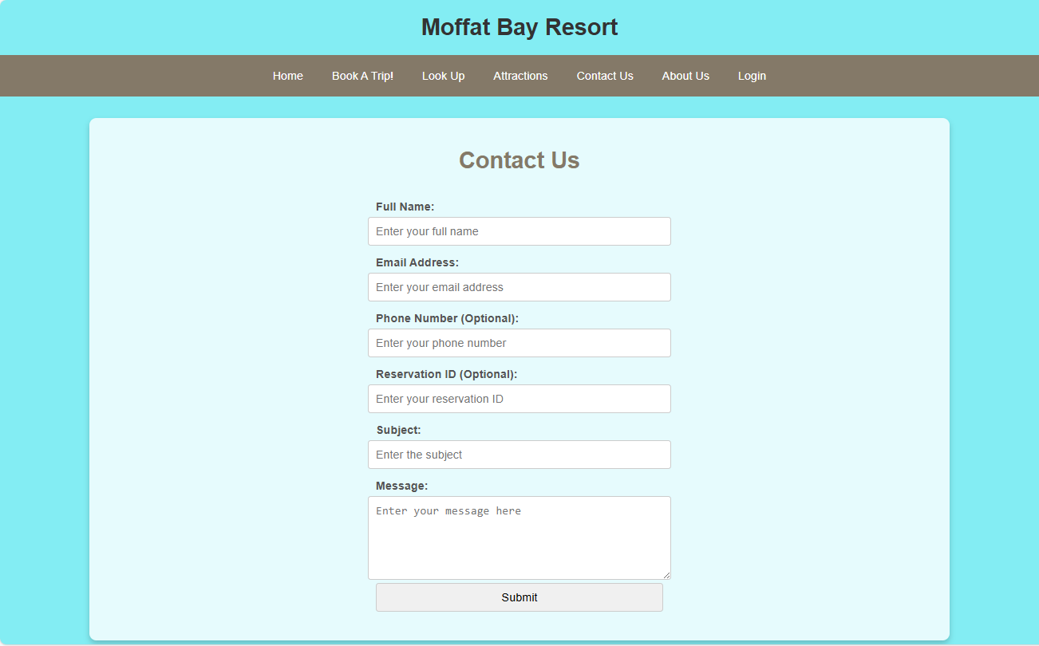
Contact us page
Contact us allows us to get in touch with you – just enter some information so we can reach out!

Slide 13
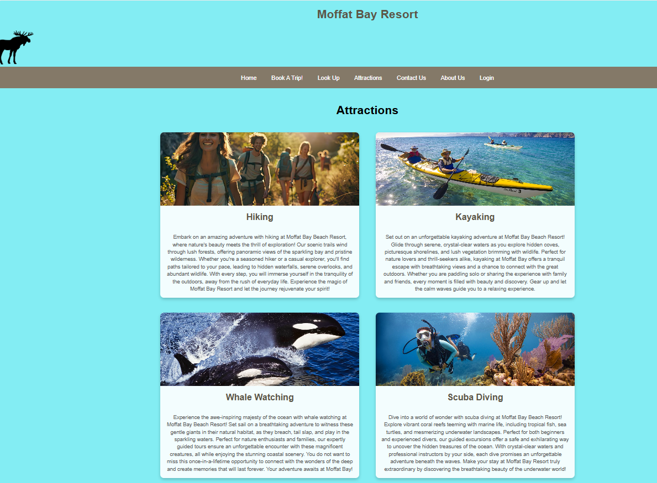
Attractions page
Attractions gives more insights to what you can experience while you stay at our resort.

Slide 14
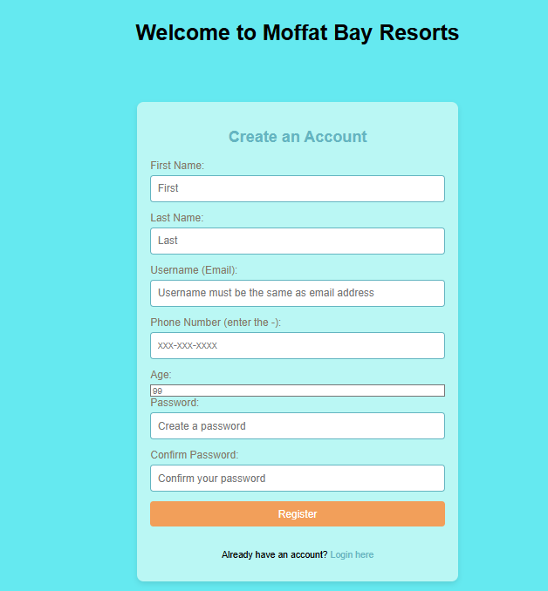
Registration page
Create an account here so you can sign in, make a booking, and lookup any existing booking.

Slide 15
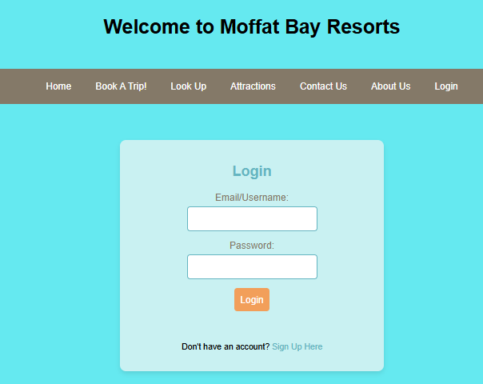
login page
Login here to make a booking and see your existing bookings.

Slide 16
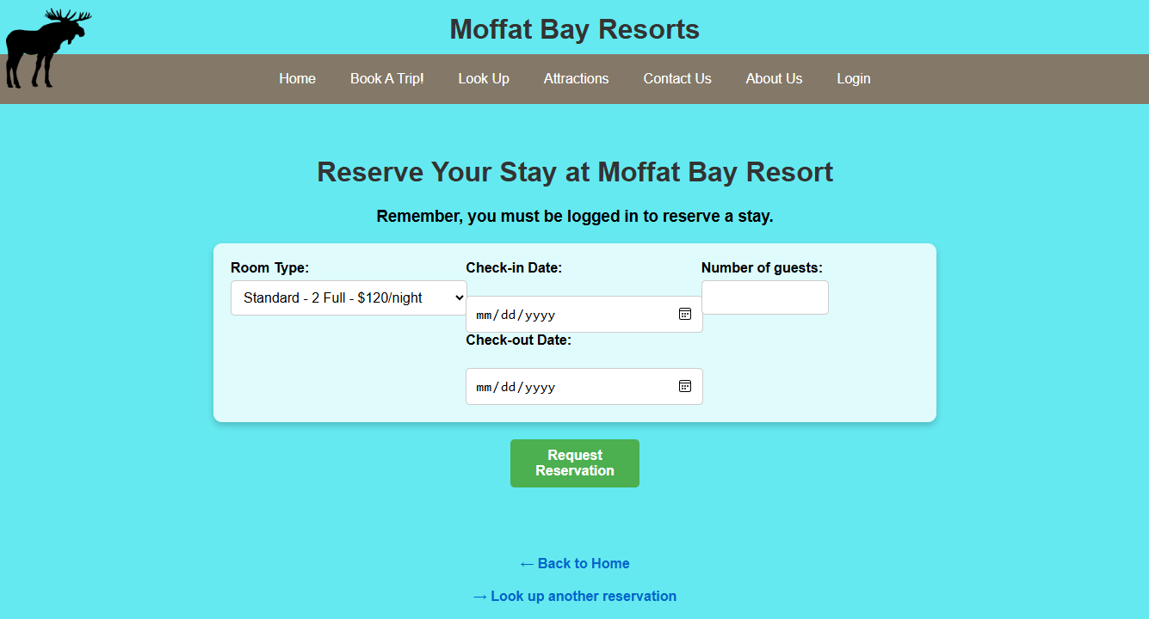
reservation page
Choose between 4 rooms (Standard, Deluxe, Formal and Presidential). A user-friendly drop-down calendar allows for easy choosing of dates.

Slide 17
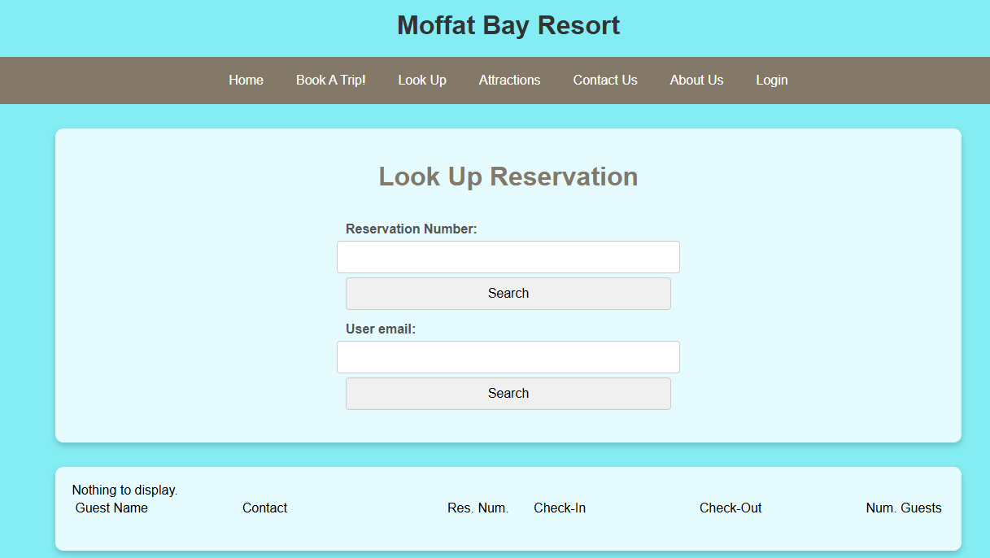
Lookup Reservation & summary page
Look up your reservation here to see your reservation number along with the details about your booking. You can look it up either through a reservation number or your email you made the booking through.

Slide 18
Favorite features
Cool features
Each devs favorite?
Only product specifically dedicated to this niche market
First beautifully designed product that's both stylish and functional
Conducted testing with college students in the area
Designed with the help and input of experts in the field

Slide 19
Lessons Learned
Team Environment – learning to work with each other, understand deadlines better, and overcoming obstacles
Communication – working with each others' schedules, consistent routines and assignments of tasks and realistic goals and expectations of these tasks
Dependency – learning to rely on others to complete certain tasks
Software Setup – Admin errors when using software causing the program not to run properly > specific settings within eclipse itself
Time Management – Work and School conflicts created some burdens and delays in certain completion timelines
Collaboration – Group board in blackboard not as user friendly as Discord > switched early on to have better collaboration

Slide 20
Probably delete
Opportunity to build
Fully inclusive market
Total addressable market
Freedom to invent
Selectively inclusive market
Serviceable available market
 | Clients | Orders | Gross revenue | Net revenue
20XX | 10 | 100 | $10,000 | $7,000
20XX | 20 | 200 | $20,000 | $16,000
20XX | 30 | 300 | $30,000 | $25,000
20XX | 40 | 400 | $40,000 | $30,000

Slide 21
Probably delete
Our product makes consumer lives easier, and no other product on the market offers the same features
Gen Z (18-25 years old)
Reduce expenses for replacement products
Simple design that gives customers the targeted information they need
Close the gap
Target audience
Cost savings
Easy to use

Slide 22
Probably delte
 | Year 1 | Year 2 | Year 3
Income
Users | 50,000 | 400,000 | 1,600,000
Sales | 500,000 | 4,000,000 | 16,000,000
Average price per sale | 75 | 80 | 90
Revenue @ 15% | 5,625,000 | 48,000,000 | 216,000,000
Gross profit | 5,625,000 | 48,000,000 | 216,000,000

Slide 23
Thank you
Link our git hub? And idk

